Slide 1
Software Requirement Engineering
Problem Analysis
Muhammad Nasir
m.nasir@iiu.edu.pk

Slide 2
Outline
What is Problem?
What is Problem Analysis?
Problem vs. Opportunity
Workarounds
5 Steps Problem Analysis

Slide 3
What is Problem?
“A problem can be defined as the difference between things as perceived and desired”.
If user perceives something as a problem, it should be addressed.

Slide 4
Goal - Problem Analysis
The goal of problem analysis is to gain a better understanding of the problem being solved before development begins

Slide 5
Problem Analysis
“The process of understanding real world problems and user needs and proposing solutions to meet those needs”.

Slide 6
Problem vs. Opportunity
System is built to
Solve a problem
Take advantage of opportunities
2 sides of same coin, matter of perspective.

Slide 7
Problem Analysis
Sometimes, the simplest solution is a workaround, or revised business process, rather than a new system.
Changing the user's desire or perception may be the most cost-effective approach to address a problem.
It is recommended to explore these alternative solutions before leaping into a new system solution.

Slide 8
Workarounds
Incremental improvements to existing systems
Providing alternative solutions (i.e. Upgrades) that do not require new system development (e.g., Android upgrades for mobile phone)
Providing additional training if there any problems to operate current systems

Slide 9
When workarounds fail !
However, when these alternative activities fail to reduce this gap,
then we have to actively reduce the distance between perception and desire by defining and implementing new systems

Slide 10
5 Steps: Problem Analysis
Gain agreement on the problem definition
Understand the root causes, the problem behind the problem
Identify the stakeholders and the users
Define the solution system boundary
Identify the constraints to be imposed on the solution.

Slide 11
STEP1: Gain Agreement on the Problem Definition
The first step is to gain agreement on the definition of the problem to be solved.
One of the simplest ways to gain this agreement is to simply write the problem down and see whether everyone agrees.
It is often helpful to understand some of the benefits of a proposed solution
Having the user describe the benefits provides additional contextual background on the real problem.

Slide 12
The Problem Statement
Problem | Description
The Problem of | Describe the problem.
Affects | Identify stakeholders affected by the problem.
The result of which (Impact) | Describe the impact of this problem on stakeholders and business activity.
Benefits of | Indicate the proposed solution and list a few key benefits.

Slide 13
STEP2: Understanding Root Cause
Once you understand the larger problem, your team can use a variety of techniques to gain an understanding of its causes.
One such technique is root cause analysis, which is a systematic way of uncovering the root, or underlying, cause of an identified problem.

Slide 14
Example: Root Cause
A manufacturing company sells a variety of inexpensive, miscellaneous items for home and personal use.
Company addresses the problem of Insufficient Profitability
Company finds-out inconsistencies in Costs

Slide 15
STEP2: Understanding Root Cause
This cost includes rework, scrap, customer dissatisfaction, employee turnover, and other negative-value activities.
Production waste, or "scrap," was found to be one of the largest contributors
To identify the problems behind the problem fishbone diagram may be used.
Each source that contributes towards failure are listed as one of the "bones" on the diagram.

Slide 16
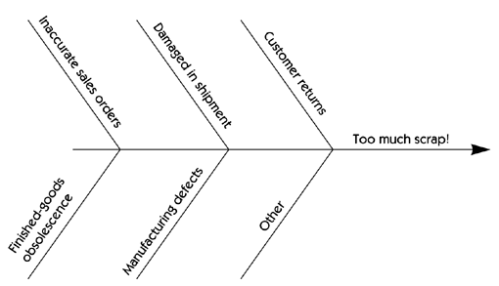
Fish Bone Diagram

Slide 17
How to perform Root Cause Analysis?
How do you determine the root causes? In many cases, it's a simple matter of asking the people directly involved what they think the root cause is.
This could vary from perhaps simple brainstorming by participants to a small data collection project, i.e., Survey

Slide 18
Addressing the Root Cause
The data demonstrates that many root causes are simply not worth fixing
The results of this investigation can be plotted as a simple histogram that visually exposes the real culprits.

Slide 19
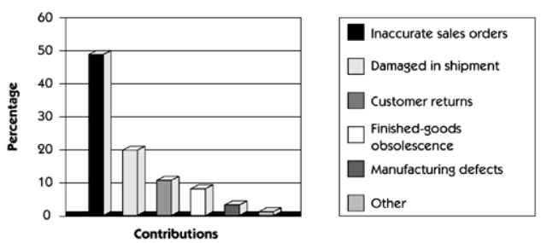
Addressing the Root Cause

Slide 20
Problem Statement
Once we have identified inaccurate sales orders as a root cause of a problem worth solving,
We can create a problem statement for the sales order entry problem

Slide 21
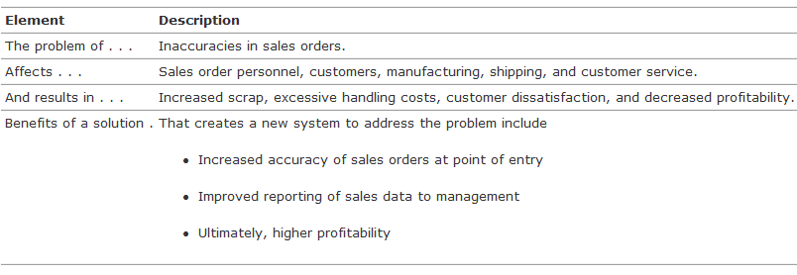
Problem Statement

Slide 22
Step 3: Identify System Stakeholders and Users
Understanding the needs of the users and other stakeholders is a key factor in developing an effective solution.
Many stakeholders are users of the system, and their needs are easy to focus on because they will be directly involved with system use.
However, some stakeholders are only indirect users of the system or are affected only by the business outcomes that the system influences.
For example, they include the people and organizations involved in the development of the system, the subcontractors, the customer's customer
Non-user stakeholder needs must also be identified and addressed.

Slide 23
Step 3: Identify System Stakeholders and Users
The following questions can be helpful in this process.
Who are the users of the system?
Who is the customer (buyer) for the system?
Who else will be affected by the outputs the system produces?
Who will evaluate and approve the system when it is delivered and deployed?
Are there any other internal or external users of the system whose needs must be addressed?
Who will maintain the new system?
Is there anyone else who cares?

Slide 24
Step 4: Define System Solution Boundary
The system boundary defines the border between the solution and the real world that surrounds the solution.
In other words, the system boundary describes an envelope in which the solution system is contained

Slide 25

Step 4: Define System Solution Boundary
All interactions with the system occur via interfaces between the system and the external world

Slide 26
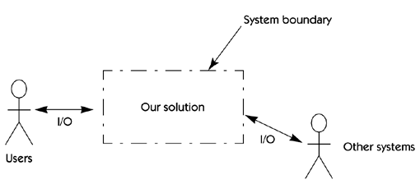
Step 4: Define System Solution Boundary

Slide 27
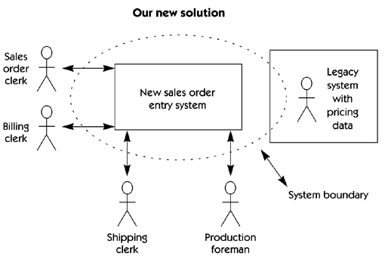
Step 4: Define System Solution Boundary

Slide 28
Step 4: Define System Solution Boundary
In our order entry system example,
New system is to be integrated into an existing legacy system; the boundaries are not so clear.
The analyst must determine whether data is shared with other applications,
Whether the new application is to be distributed across various hosts or clients, and who are the users?
For example, should the production people have online access to sales orders?
Will specialized management reports be provided?

Slide 29
Step 5: Identify the constraints imposed on system
Constraints are restrictions on the degree of freedom we have in providing a solution.
Each constraint has the potential to severely restrict our ability to deliver a solution as we visualize it.
Therefore, each constraint must be carefully considered as part of the planning process.
These constraints may be given to us before we even begin, or we may have to actively elicit them.

Slide 30
Step 5: Identify the constraints imposed on system
Schedule & Resources
Economics
Politics
Technology
Systems
Environment

Slide 31
The End
Thanks for listening
Questions would be appreciated.

